Slide 1
Module 2 of Mechanics

Slide 2
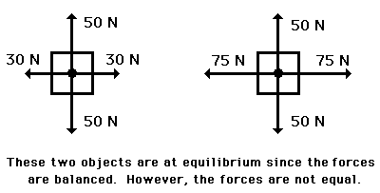
EQUILIBRIUM
When all the forces that act upon an object are balanced, then the object is said to be in a state of equilibrium.
The forces are considered to be balanced if the rightward forces are balanced by the leftward forces and the upward forces are balanced by the downward forces.
This however does not necessarily mean that all the forces are equal to each other.

Slide 3
Since the net force is zero , the acceleration is 0 m/s/s.
Objects at equilibrium must have an acceleration of 0 m/s/s.
This extends from Newton's first law of motion which states that every object will remain at rest or in uniform motion in a straight line unless compelled to change its state by the action of an external force, which is normally taken as the definition of inertia.
But having an acceleration of 0 m/s/s does not mean the object is at rest.
An object at equilibrium is either ...
at rest and staying at rest, or in motion and continuing in motion with the same speed and direction. This too extends from Newton's first law of motion.
Reference:
https://www.physicsclassroom.com/class/vectors/Lesson-3/Equilibrium-and-Statics

Slide 4
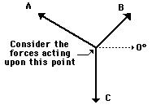
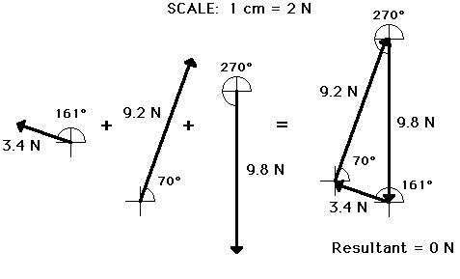
Analyzing a Static Equilibrium Situation
 | Force A | Force B | Force C
Magnitude | 3.4 N | 9.2 N | 9.8 N
Direction | 161 deg. | 70 deg. | 270 deg

Slide 5
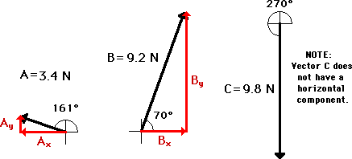
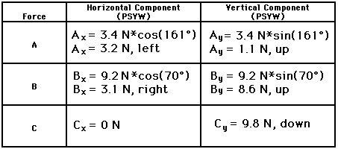
RESOLVING FORCES HORIZONTALLY AND VERTICALLY

Slide 6
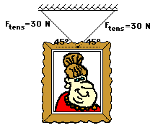
The following picture is hanging on a wall. Use trigonometric functions to determine the weight of the picture.
Ans: W= 42N

Slide 7
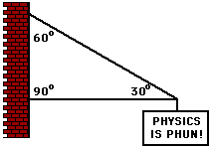
The sign below hangs outside the physics classroom. The sign is supported by a diagonal cable and a rigid horizontal bar. If the sign has a mass of 50 kg, then determine the tension in the diagonal cable that supports its weight.
Ans : T=980 N

Slide 8
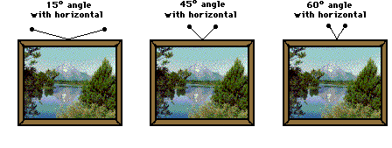
Concept Check
As the angle with the horizontal increases, the amount of tensional force required to hold the sign at equilibrium decreases
Weight of the picture board is 10N. Find the tension in the string. What is the understanding you arrive at, from the three answers .

Slide 9
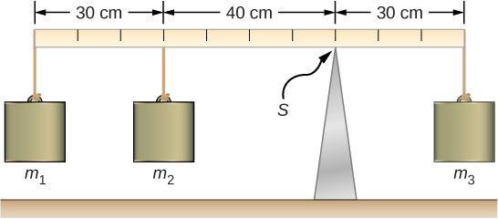
Three masses are attached to a uniform meter stick. Find the mass m3 that balances the
system and the normal reaction force at the fulcrum. (m1 = 50g and m2=75g).The
mass of the stick is 150 g.
M3 = 320 g
Fs = 5.8 N

Slide 11
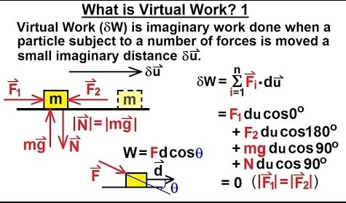
Virtual displacement:
Virtual/ Infitisimal Displacement is not experienced but only assumed to exist so that various possible equilibrium positions may be compared to determine the correct one

Slide 12
Method of Virtual Work
Method of Virtual Work is suitable for analysis of multi-link structures (pin-jointed members) which change configuration.
This is effective when a simple relation can be found among the displacement of the points of application of various forces involved.
It is based on the concept of work done by a force.
This enables us to examine stability of systems in equilibrium.

Slide 13
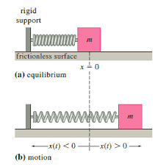
Principle of Virtual Work:
Principal of virtual work is used to get governing equations for deformation of structures under static equilibrium
Let the spring constant of spring be k
The force in the forward direction be F
And the virtual displacement be x
The system is in static equilibrium
now

Slide 14
We can find any one parameter let’s say ‘x’ in this case using either force balance method or PVW
By Force balance method
By PVW
N
Suppose this system is given a
virtual displacement ‘δ’ in the right
direction, virtual work done on
the system would be
δw = 0
δw = -kx.δ + F.δ
= (- kx + F)δ =0
x=F/k
kx
F
mg
Since vertical movement is restricted in this case
∑F_{H} = 0
-kx + F = 0
X=F/k

Slide 15
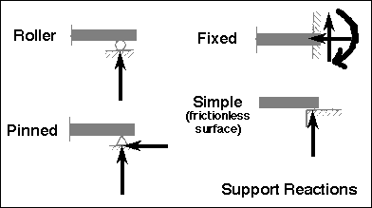
So why PVW?
When the structure becomes complicated the equations governing method of force balance also becomes complicated and PVW is relatively easier to study the structure
The three common types of connections which join a built structure to its foundation are; roller, pinned and fixed. A fourth type, not often found in building structures, is known as a simple support. This is often idealized as a frictionless surface)

Slide 16
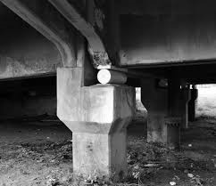
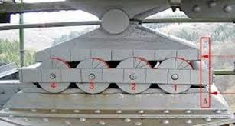
Roller supports are free to rotate and translate along the surface upon which the roller rests. The surface can be horizontal, vertical, or sloped at any angle. The resulting reaction force is always a single force that is perpendicular to, and away from, the surface. Roller supports are commonly located at one end of long bridges. This allows the bridge structure to expand and contract with temperature changes. The expansion forces could fracture the supports at the banks if the bridge structure was "locked" in place. Roller supports can also take the form of rubber bearings, rockers, or a set of gears which are designed to allow a limited amount of lateral movement.

Slide 17
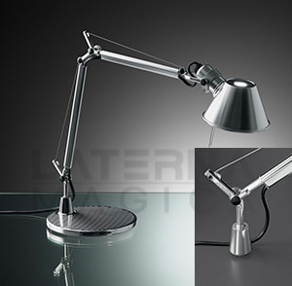
A pinned support can resist both vertical and horizontal forces but not a moment. They will allow the structural member to rotate, but not to translate in any direction. Many connections are assumed to be pinned connections even though they might resist a small amount of moment in reality. It is also true that a pinned connection could allow rotation in only one direction; providing resistance to rotation in any other direction. The knee can be idealized as a connection which allows rotation in only one direction and provides resistance to lateral movement. The design of a pinned connection is a good example of the idealization of the reality. A single pinned connection is usually not sufficient to make a structure stable. Another support must be provided at some point to prevent rotation of the structure.
Pinned support

Slide 18
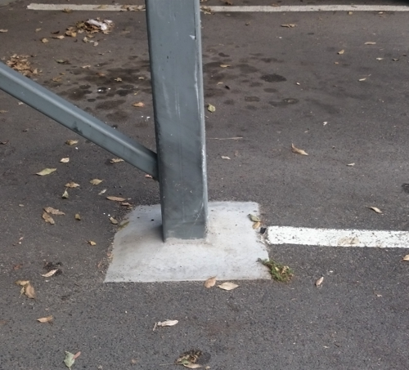
Fixed supports can resist vertical and horizontal forces as well as a moment. Since they restrain both rotation and translation, they are also known as rigid supports. This means that a structure only needs one fixed support in order to be stable. All three equations of equilibrium can be satisfied. A flagpole set into a concrete base is a good example of this kind of support.

Slide 19
Simple supports are idealized by some to be frictionless surface supports. simple support cannot resist lateral loads of any magnitude. For example, if a plank is laid across gap to provide a bridge, it is assumed that the plank will remain in its place. It will do so until a foot kicks it or moves it. At that moment the plank will move because the simple connection cannot develop any resistance to the lateral load.
Simple support
Reference:
http://web.mit.edu/4.441/1_lectures/1_lecture13/1_lecture13.html
https://youtu.be/Y4861IUnUUA

Slide 20
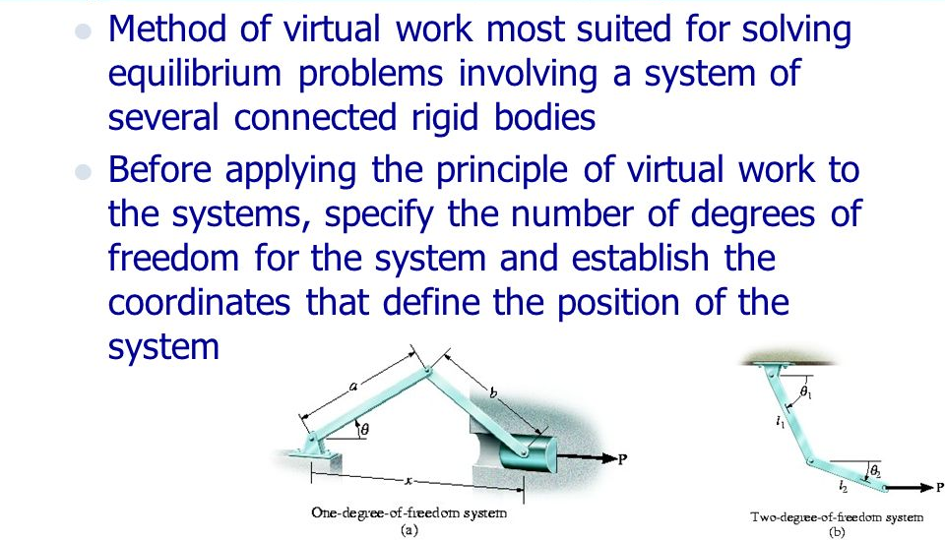
Ref:
https://slideplayer.com/slide/8365879/

Slide 21
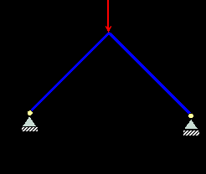
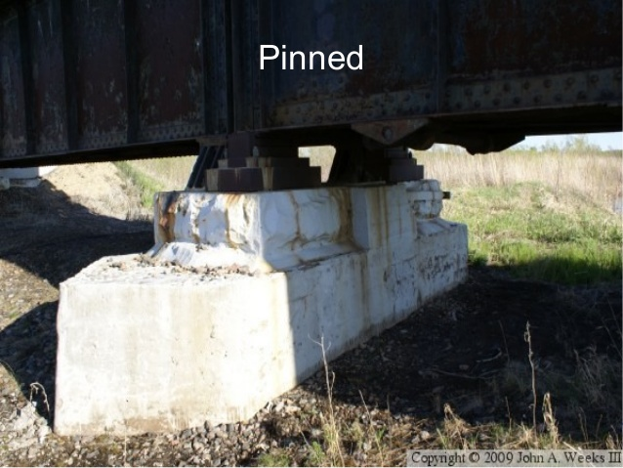
We can’t apply PVW for a locked structure because DoF =0 in this case

Slide 22
Y
Find ‘F’ using principle of virtual work
Z
x
PJ
RJ
30
F
L
L=2m
System Constraint : Y,Z axis
DoF : 1
System in st.eq
500 N

Slide 23
Case 1
dX_{c}
Case 2
dX_{c}
A
A
C
C’
C’
C
dθ
F
F
dθ
L
B’
L=2m
L
L=2m
B
dY_{B}
B’
B
dY_{B}
dY_{B}
dX_{B}
90
dX_{B}
500 N
dXc
500 N
Applying PVW
Applying PVW
dW=0
+FdXc -500dY_{B}=0
C:
F . dX_{c}
dW=0
-F.dXc+500dY_{B}=0
C:
F.dXc
B:
500.dY_{B}
B:
500 dY_{B}
=0
500. cos90 dXc

Slide 24
Consider T as θ
Which is 30º in this case
A
L cosT
O
C
L cosT
30
(2L cosT, 0)
L sinT
dXc/dT= -2LsinT
|dXc|-2LsinT.dT
dY_{B}/dT= LcosT
|dY_{B}| =LcosT.dT
L
L=2m
Sub |dXc| and |dY_{B}| in case 1 dw=0
+FdXc -500dY_{B}=0
F2LsinTdT-500LcosTdT=0
(2FsinT-500cosT)LdT=0
F=500 cosT/2. sinT
=250 x 1.732
=433N
B
(L cosT, LsinT)
Using case 2 to solve
will also yield the same result

Slide 25
dX_{c}
dX_{c}
A
A
C
C’
C’
C
dθ
F
F
dθ
L
B’
L=2m
L
L=2m
B
dY_{B}
B’
B
dY_{B}
dX_{B}
dX_{B}
500 N
500 N

Slide 28
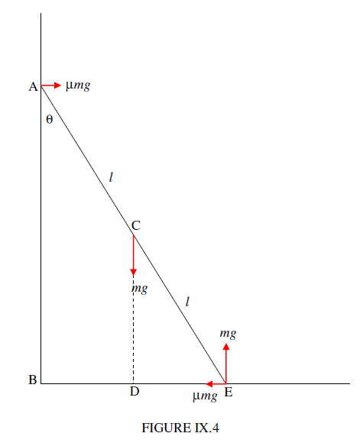
2. Consider a uniform ladder of length 2l and weight mg. It is leaning in static equilibrium against the smooth vertical wall and the rough horizontal floor whose coefficient of limiting static friction is μ. What is the angle θ that the ladder makes with the vertical wall?

Slide 29
2. Consider a uniform ladder of length 2l and weight mg. It is leaning in static equilibrium against the smooth vertical wall and the rough horizontal floor whose coefficient of limiting static friction is μ. What is the angle θ that the ladder makes with the vertical wall?

Slide 31
1.Ladder could slide at point A and so there will be a change in θ
At point C the weight of the ladder is acting and direction is down
At E Friction is opposing the movement of ladder (-x)
Virtual displacements at C and E which can be denoted as d(CD) and
d(BE)
dW = (mg). d(CD) – μ (mg).d(BE) = 0; CD = l cosθ BE = 2l sinθ
d(CD) = -l sin θ dθ
d (BE) = 2lcosθ dθ
substituting the values of |d(CD)| and |d(BE)|in dW =0 gives;
θ= tan ⁻¹(2 μ)

